Slide 1
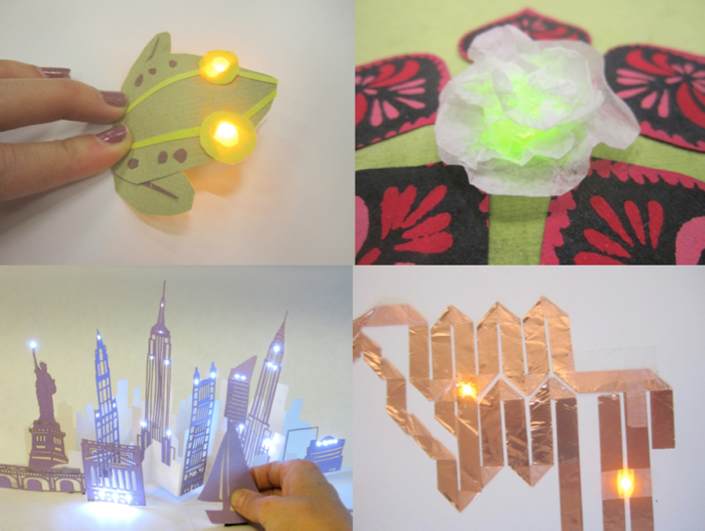
Paper Electronics

Slide 2
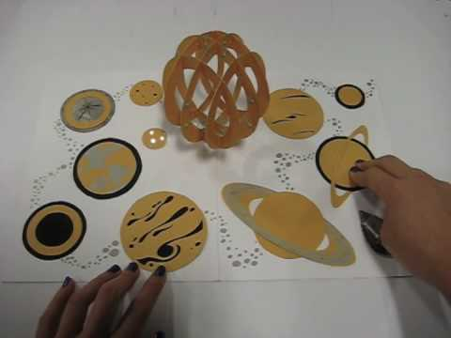
Electronic Popables by Jie Qi

Slide 3
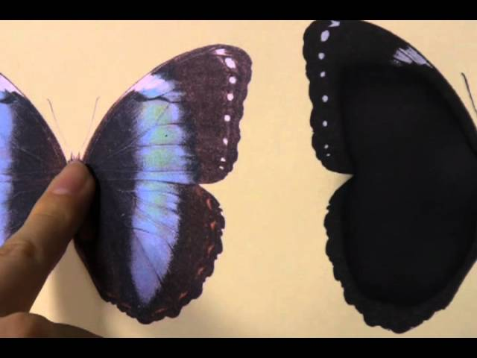
Anabiosis by Akira Wakita Lab

Slide 4
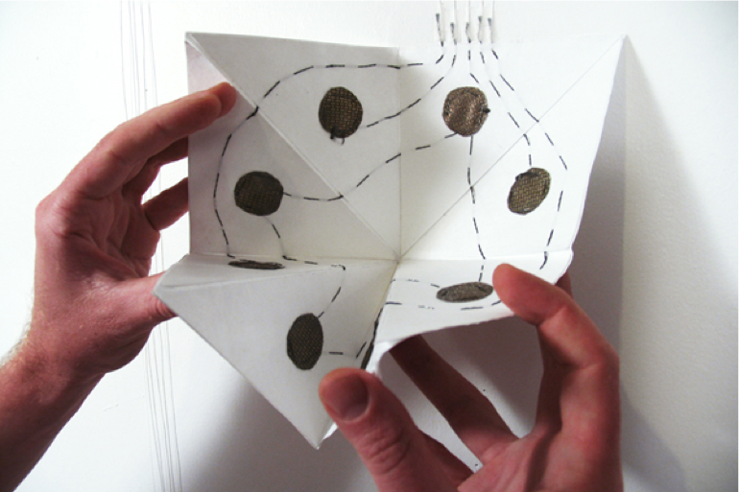
Fold Loud by JooYoun Paek

Slide 5
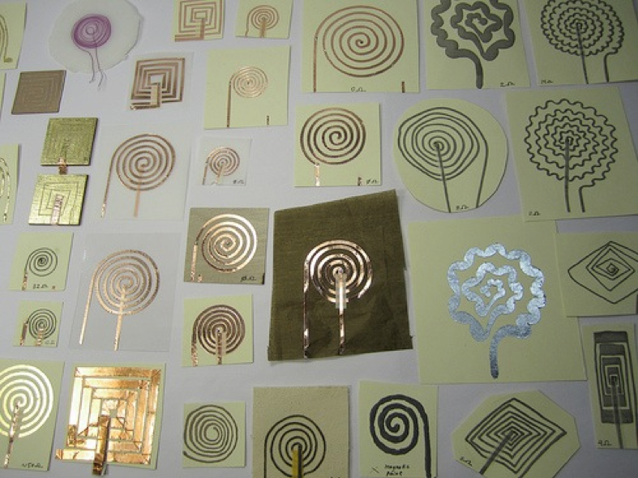
Paper Speakers by Hannah Perner-Wilson

Slide 6
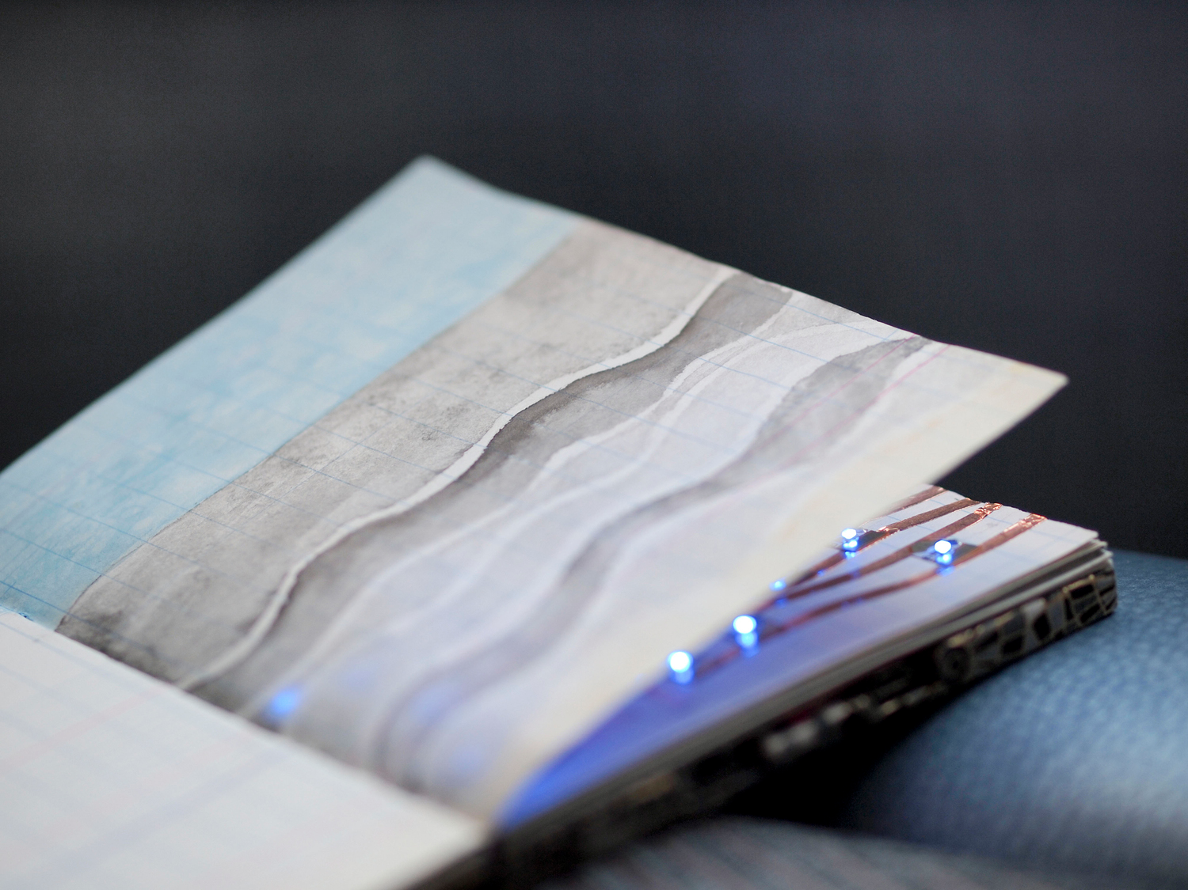
Tide Notebook by Natalie Freed

Slide 7
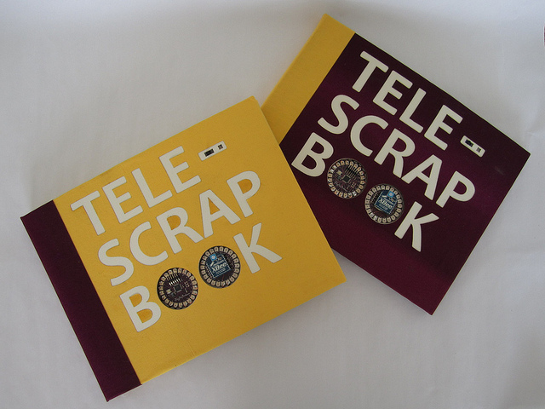
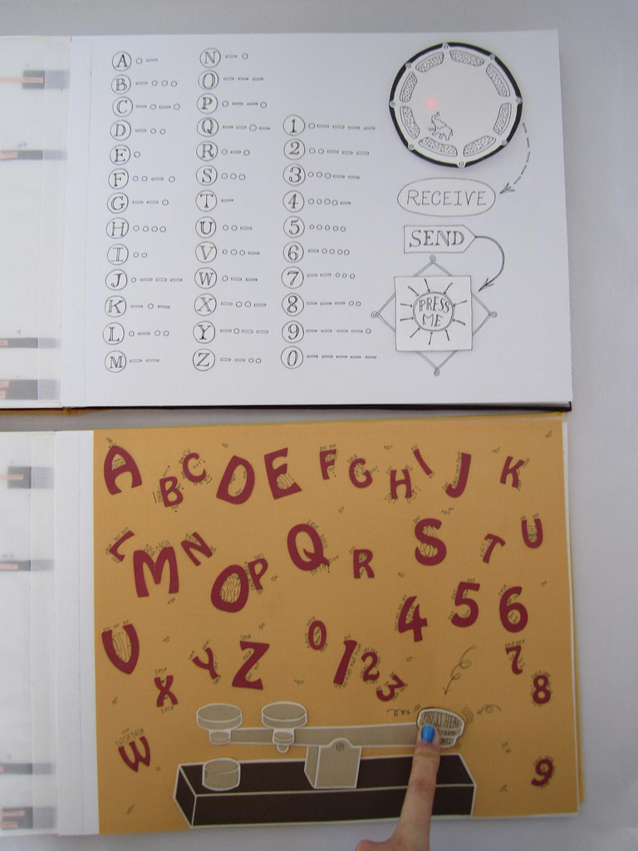
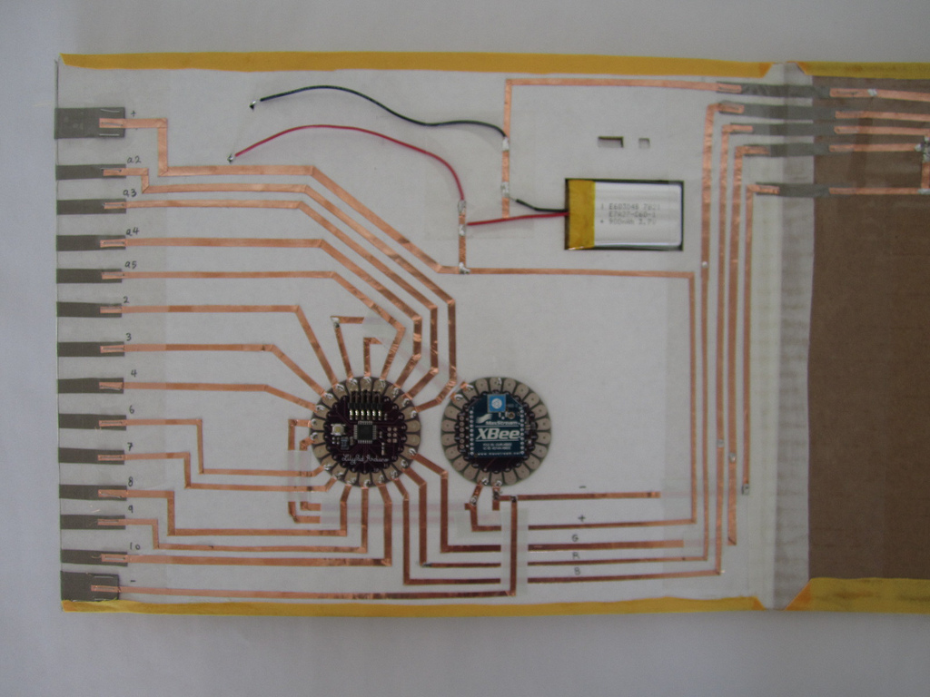
Telescrapbook by Natalie Freed, Jie Qi, Adam Setapen

Slide 8
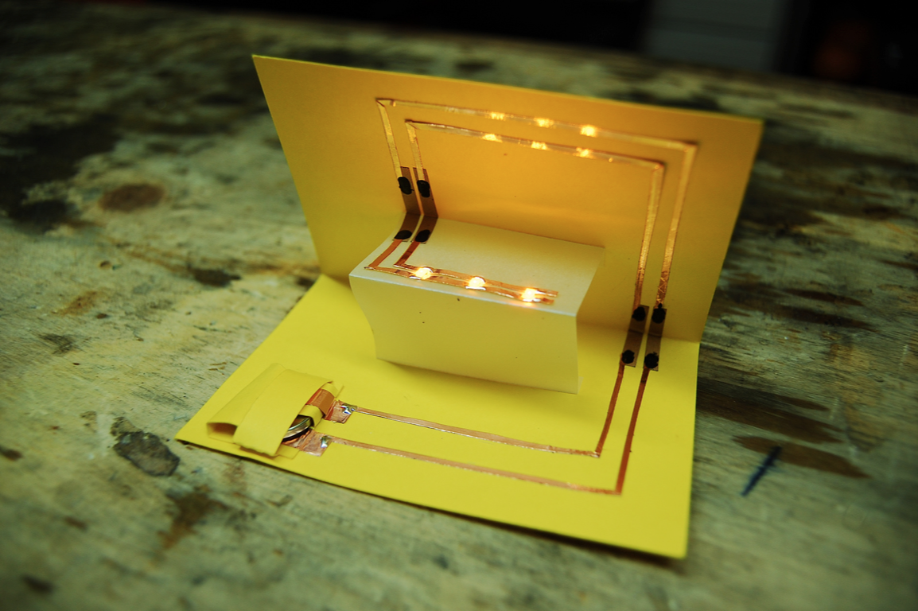

Slide 9
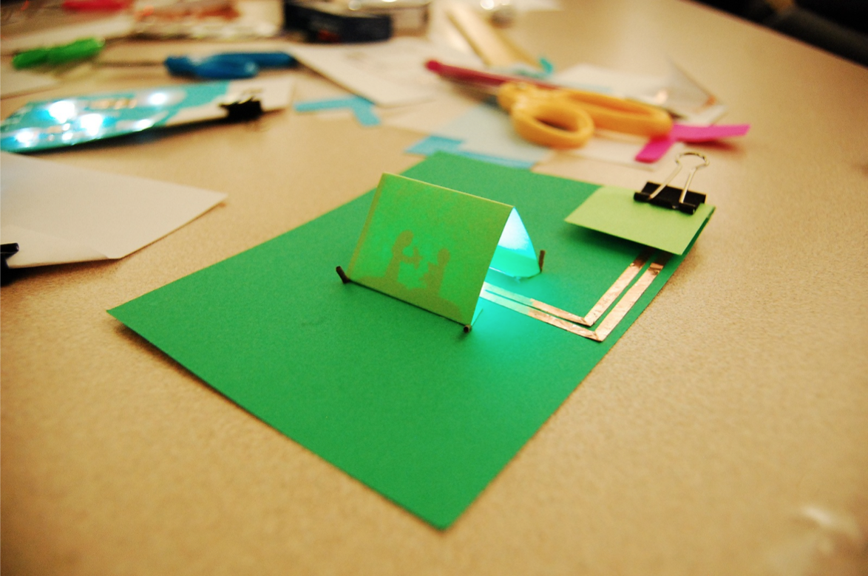

Slide 10
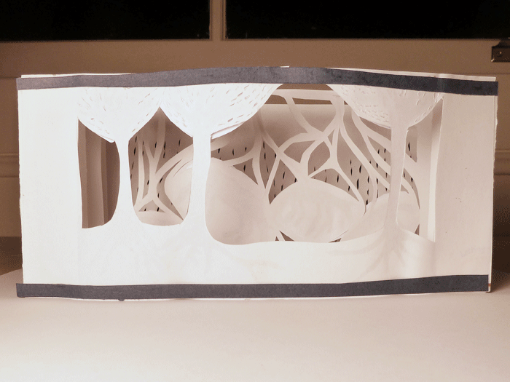
Shadowy Tunnel(ish) by Becca Rose

Slide 11
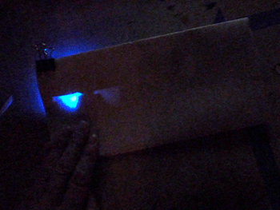
[Animated] Birds by Becca Rose

Slide 12
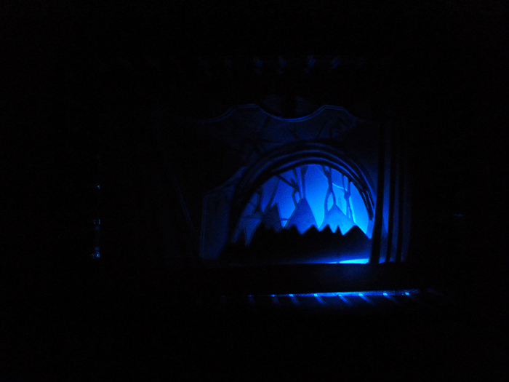
[Shadow Box] by Becca Rose

Slide 13
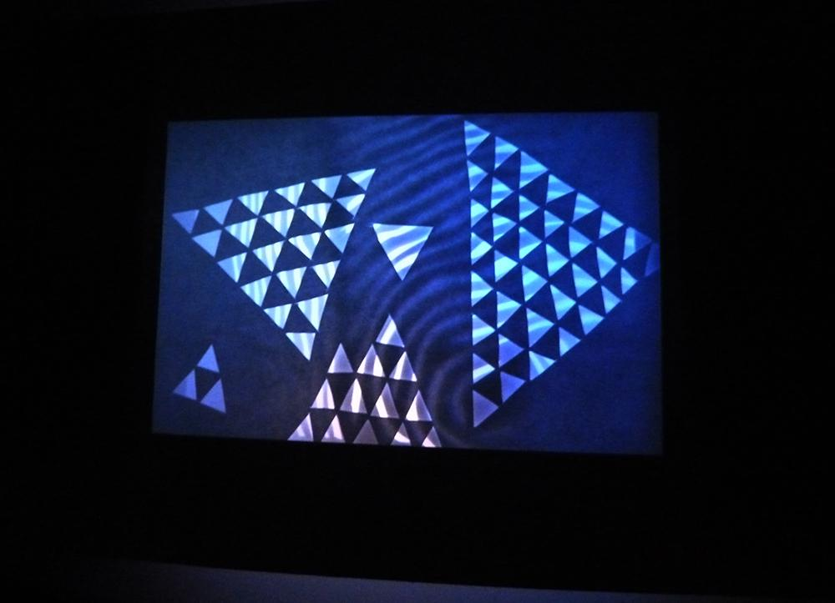
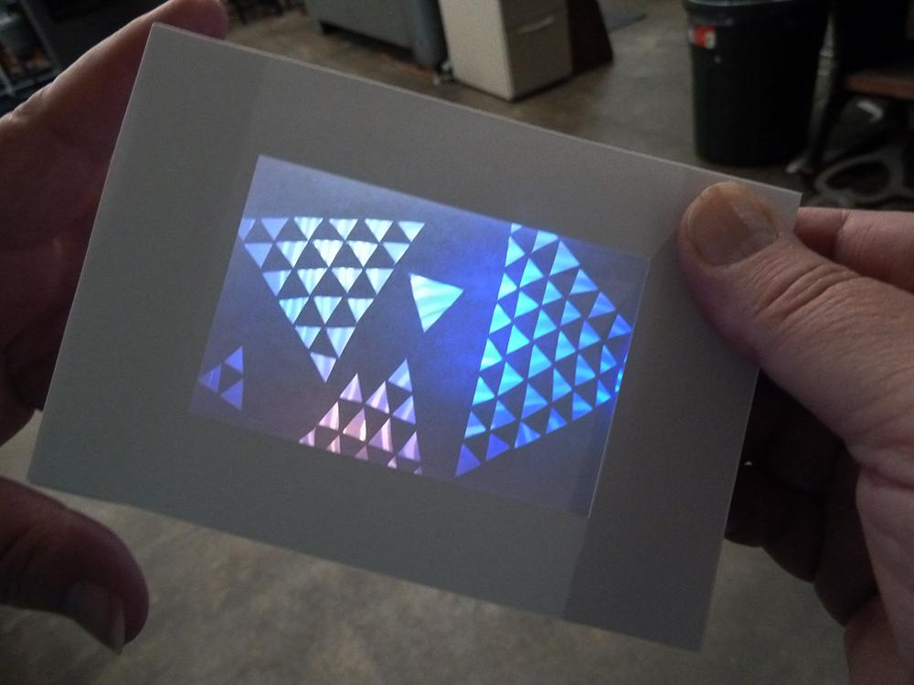

Slide 14
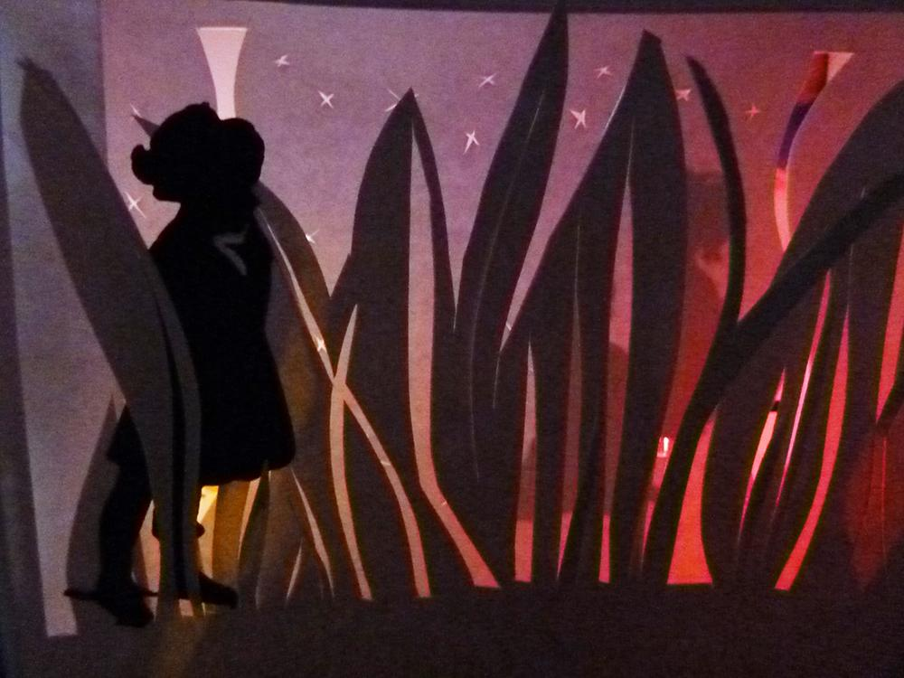
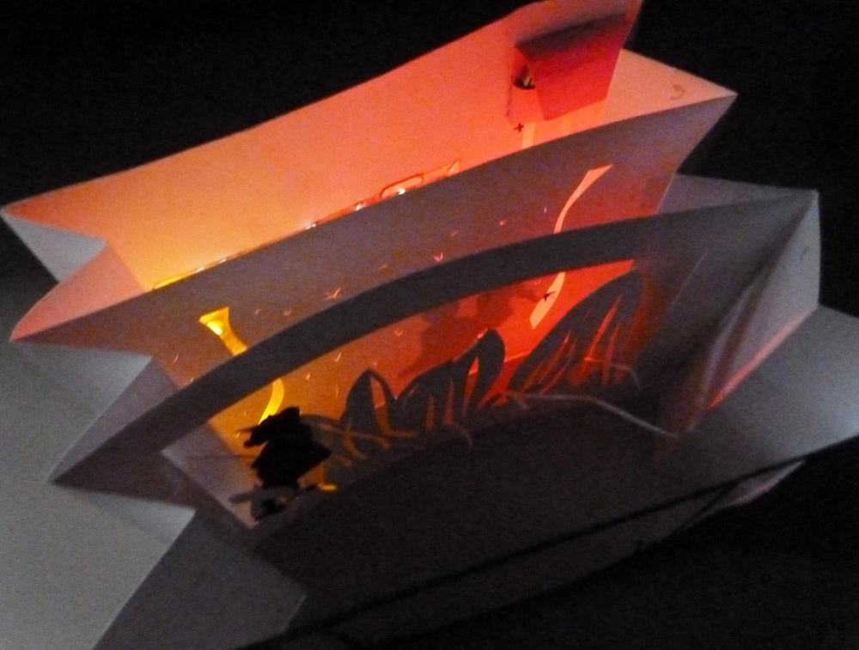

Slide 15
Circuit Building at Double Union Hackerspace in the SF Mission
333 Valencia
Announced on blog:
http://doubleunion.tumblr.com/

Slide 16
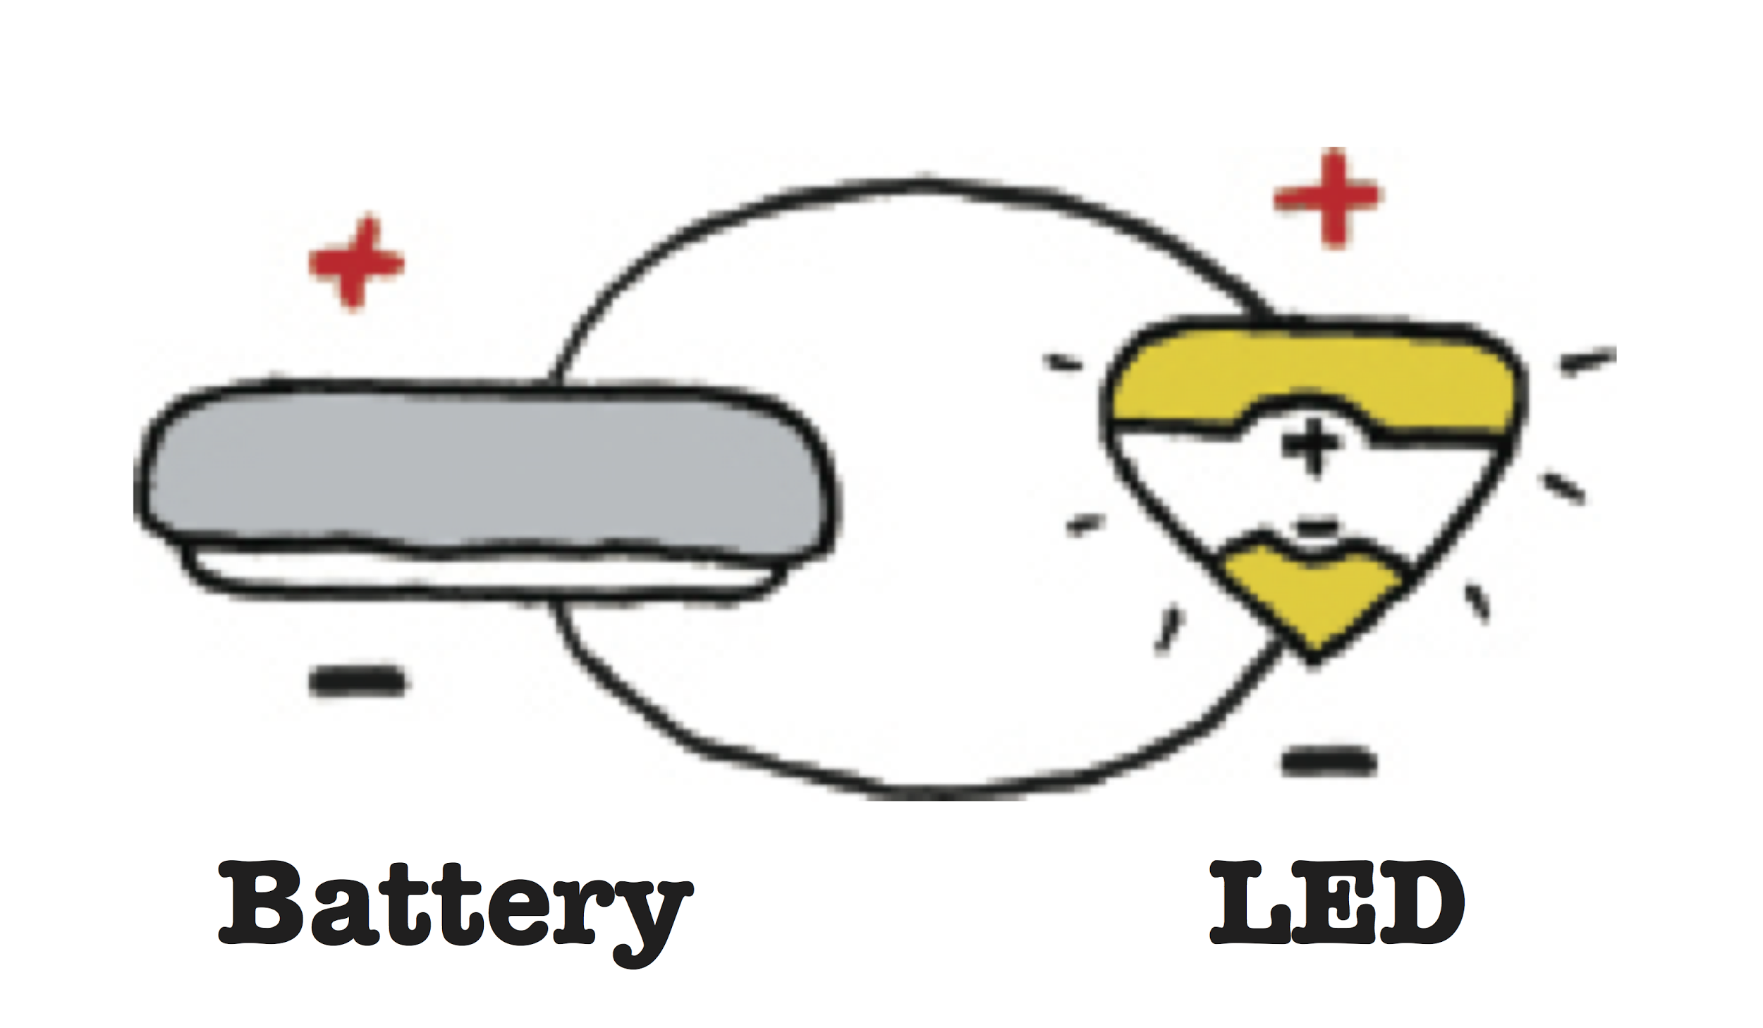
In a complete circuit (a closed loop), electrons flow continuously from one side of a battery to the other, powering anything they pass through.
With some variations, this simple circuit is all we need to power our LED lights.
Illustration by Jie Qi

